Slide 1
Story Telling for Dark Friday Data
Sharon Li

Slide 2

Summary
The data is from kaggle: https://www.kaggle.com/sdolezel/black-friday, which contains over 500 thousand data with the customer over 7 ranges of ages, 21 kinds of occupations, 3 cities and 20 sorts of products. We analysis the sale data of Black Friday from the following aspects:
▲ The sorts of best selling products
▲ The market differences between genders
▲ The purchasing power of various ages
▲ The market differences among occupations
▲ The market distribution among cities
▲ The market differences between marital status

Slide 3
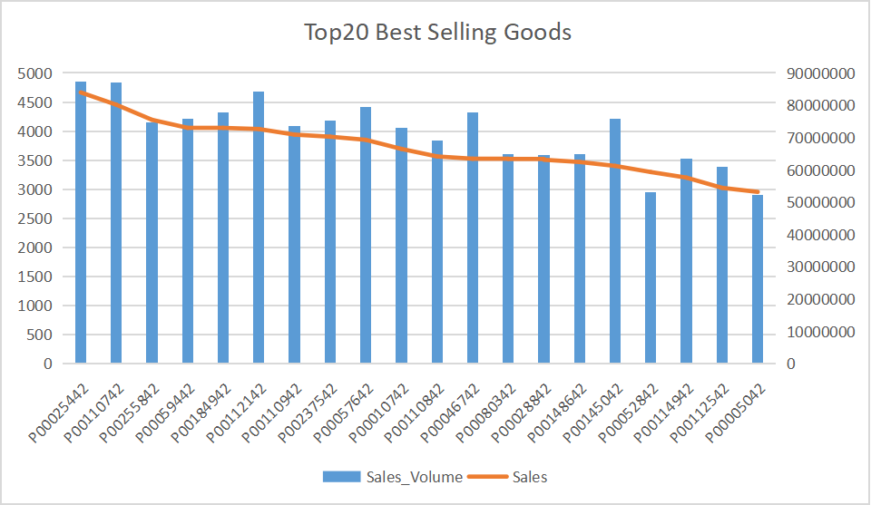
Products
The left table shows the top 20 best selling goods, with its product ID, the sale volunme, and the total sale of the certain product.
The TOP1 is ID:P00025442 with 4845 pieces sold and $ 83,985,498. Also ,the ID:P00110742 followed with 4836 pieces sold.
number of customer | number of goods sold | total sales
5891 | 1650k | $ 15 B

Slide 4
query code：
SELECT Occupation, SUM(Purchase) FROM BlackFriday GROUP BY Occupation ORDER BY SUM(Purchase) desc LIMIT 20;
Customer Profile – occupation
unit: million
Type 4, 0 and 7 Occupations prefer to purchase on Black Friday.
The chart above shows the TOP20 occupation types who consume most amount on Black Friday.
Type 4 ranks first and followed by type 0 and type 7.

Slide 5
query code：
SELECT Marital_Status,SUM(CASE WHEN Gender = 'M' THEN Purchase END), SUM(CASE WHEN Gender = 'F' THEN Purchase END) FROM BlackFriday GROUP BY Marital_Status;
Customer Profile – marital status
unit: million $
Consumptions between genders and marital status
The unmarried prefer to purchase more goods than married.
The three charts are about comparisons between marital status.
The unmarried accounts for over half of total population, but the average consumption is the same no matter people married or not.
No matter what marital status is, it still is the male group who owns more purchase power.
unit: $
Notes:
in conclusion

Slide 6

Conclusion
The most popular products in this Black Friday is P00025442.
The consumption of males is three times as much as females, while the target products are similar.
Consumer ages in 26-35 is the main part of the Black Friday. However, the 51-55 age group has the highest average consumption.
Comparing with different occupations, the consumer of J4, J0 and J7 has higher consuming level.
People in city B consume the most, where the total consumption of males is also larger than the consumption of females.
Consumers who are unmarried prefer to purchase more than those who are married and the male holds larger consumption than females as well.

